Slide 1

OSH – OCCUPATIONAL SAFETY & HEALTH
DUST EXPLOSION
NORWANI AHMAT

Slide 2








TRAINER PROFILE
Education and Credential
  Degree in Chemical & Process Engineering, UKM
  Certified International Training Practitioner (CIPD), UK
  Certified Safety & Health Officer (SHO) JKKP IS/438/2328
  PSMB Trainer Certified PSMB Trainer PSMB trainer TTT/14487
  Certified CIDB Assessor
  Certified Lead Auditor for OHSAS 18001 & ISO 14001
  Train of The Trainer (TTT)
Professional Experiences
  1999 – Diamond Chemical Industries Sdn Bhd – Chemist
  2000 – Philips Semiconductors Seremban – Process engineer
  2001 – Philips Semiconductors Seremban – EHS engineer
  2005 – Sime Darby Berhad – Sr. EHS Executive
  2009 – Faber Group Berhad – SHE Manager
  2011 – Nestle Manufacturing (M) Sdn Bhd – SHE Manager
  2013 – MMC Gamuda (PDP) KVMRT – Safety and Health Manager
  2014 – Proton Holdings Berhad– Senior SHE Manager/Head Of Department

Slide 3
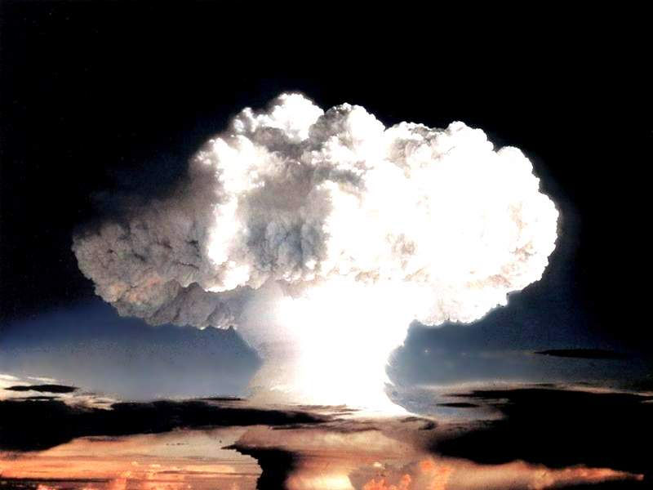
DUST EXPLOSION

Slide 4
CONTENT
Introduction
Dust explosion - Safety perspective
Dust explosion - Health perspective
Root causes of dust explosion
How to prevent dust explosion

Slide 5
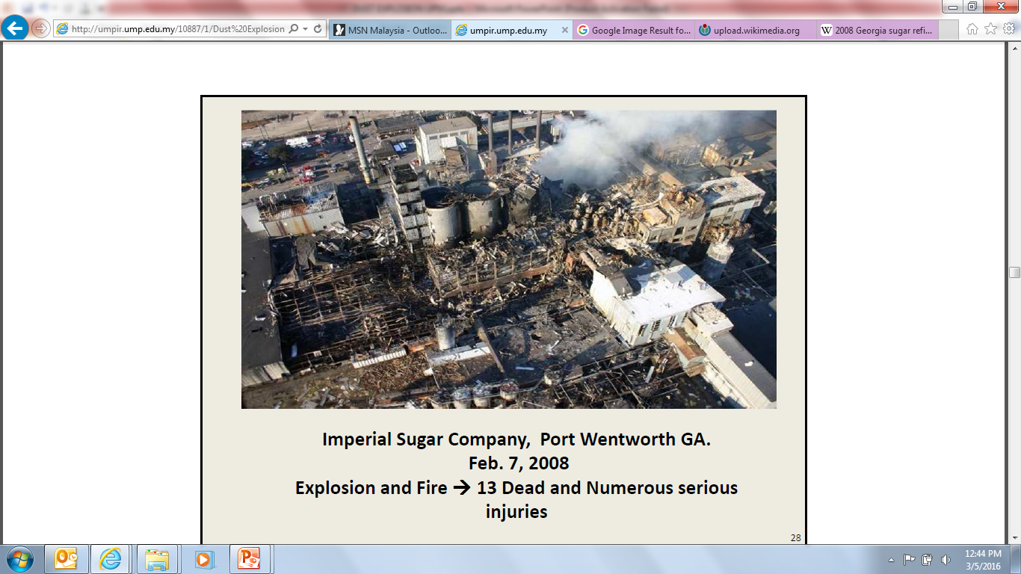
The 2008 Georgia sugar refinery explosion was an industrial disaster that occurred on February 7, 2008 in Port Wentworth, Georgia, United States.
14 people were killed and 42 injured when a dust explosion occurred at a sugar refinery owned by Imperial Sugar.

Slide 6
Lesson Learned
“The refinery was large and old, featuring outdated construction methods, and these factors are believed to have contributed to the fire's severity. The origin of the explosion has been narrowed down to the center of the factory. It was believed to have occurred in a basement beneath storage silos.”

Slide 7
INDUSTRIAL ACCIDENT IN MALAYSIA
Dust explosion in a chemical processing plant has resulted in fatality of two workers, whilst two others were seriously injured in the face and body. The plant activity is processing Stearate based chemical for medicines and cosmetics purposes. Investigation found that there are several conditions which could trigger the dust explosion:
(1) dusty environment;
  (2) confined area;
  (3) presence of oxygen;
  (4) dispersion of dust
  (5) existence of ignition.

Slide 8
Lesson Learned
Local Exhaust Ventilation (LEV) system should be installed in appropriate areas that have potential to produce high quantities of dust. This system should be designed in accordance to standards by registered Professional Engineer
As a general guide, the following formula may be used to estimate allowable dust thickness due to housekeeping
Dusting with compressed air or sweeping is not recommended. Use of vacuum cleaner recognized for industrial use and can efficiently carry out work to suck dust which constantly scattered around the processing area;
Conduct risk assessment (HIRARC) on dust explosion hazard; management should provide Safe Working Procedures for works and processes which have higher risk in causing fire and dust explosion;
Ensure the information, instruction, guidance and training as well as effective supervision given to operators or employees who work in areas which have potential in producing large quantities of dust and;
Ensure all machines, electrical fittings are intrinsically safe and comply to standards; and
Conduct specific training to all employees about the risk of dust explosion

Slide 9
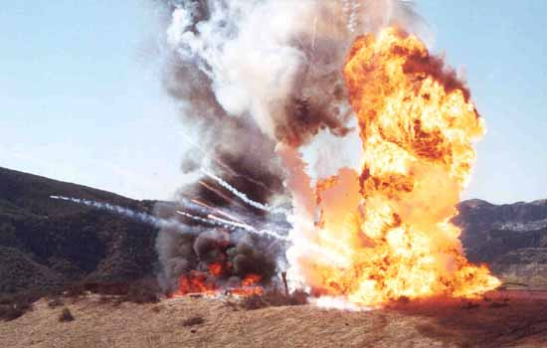
SAFETY PERSPECTIVE

Slide 10

WHAT IS DUST?
Dust is defined as powders with particles less than about 500 micrometres in diameter.
Mineral Dust Regulations 1989
25 list of minerals
Clay
Cristobalite
Graphite
Kaolin
Limestone
Magnesite
Marble

Slide 11

TYPE OF CHEMICALS
All chemicals exists in one of the three forms:
  Solid
  Gas
  Liquid
NOTE: Dust in a solid form.

Slide 12
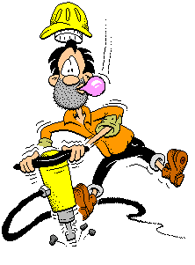
SOLID – DUST
Dust or powder can be released into the air by cutting, drilling, grinding or sanding and inhaled.
Dust can also be stirred up by dry sweeping and inhaled.
Dust in the air can settle out on work surfaces, cups, plates, utensils and food.
The settled dust can be swallowed with food or drinks.

Slide 13
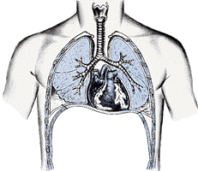
HEALTH PERSPECTIVE

Slide 14

WHAT IS HAZARD?
Source, situation or act with a potential for harm in terms of human injury or ill health , or a combination of these
NOTE: Definition from OHSAS 18001 standard

Slide 15
DUST IS A ‘HAZARDOUS CHEMICAL’
A hazardous chemical is any chemical that can do harm to your body.
Most chemicals can harm you at some level.
It depends only on how much it gets into your body.

Slide 16
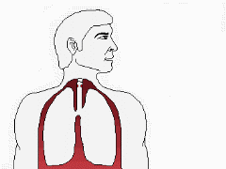

HOW DO HAZARDOUS CHEMICALS EFFECT THE BODY?
The effects of chemicals on the human body depend on several factors:
(1)
INHALATION
(3)
INGESTION
(2)
ABSORPTION

Slide 17




^{CHEMICAL HAZARD}
  Very Toxic
  Toxic
  Corrosive
  Harmful
  Irritant
  Explosive
  Oxidizing
  Extremely Flammable
  Highly Flammable
  Flammable
HEALTH
PHYSICO
CHEMICAL
Notes:
P7
EXPLAIN :
There are many types of classifications of hazards available but this is a simple one and easy for them to understand. We are concern with the hazards which could contribute to an acute injuries which might need first aid measures.This list of hazards is not exhaustive and they can add on their own depending on the types of hazards they encounter in their workplace.
DESCRIBE :
The classification of hazards under each group of hazard ( Safety and Health ) with a few examples.
EXPLAIN :
That classifications of hazards is useful in hazard Identification to avoid unidentified hazard. Therefore it is important to classify types of hazards in the checklist form proceed with hazard identification

Slide 18
OCCUPATIONAL EXPOSURE STANDARD (FMA 1967)
Permissible Exposure Limit:
  Mineral Dust:
    5 mg/m³ for respirable dust
    10 mg/m³ for total dust
    0.1 mg/m³ for respirable quartz
18

Slide 19


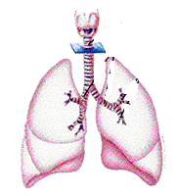
HEALTH EFFECT
SOURCES
Mineral dust : silica, semen, graphite, kaolin etc.
b. Metal dust :
(like aluminum and titanium), can form explosive suspensions in air.
c. Non organic dust :
grain, flour, sugar, powdered milk and pollen
EFFECT
Skin diseases
Respiratory illness
(asthma),
bronchitis,
pneumonia-
koniosis

Slide 20
DUST EXPLOSION

Slide 21
DUST EXPLOSION
A dust explosion is the fast combustion of dust particles suspended in the air in an enclosed location.
Dust explosions can occur where any powdered combustible material is present in an enclosed atmosphere.

Slide 22





CONDITIONS FOR FIRE
Material
Oxygen
Heat
FIRE

Slide 23
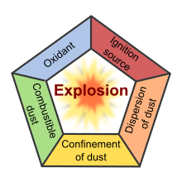
DUST EXPLOSION
√
√
√
Require 5 Elements Simultaneously
There are FIVE necessary conditions for a dust explosion:
A combustible dust
There is an oxidant (typically atmospheric oxygen)
There is an ignition source
The dust is suspended in the air at a sufficiently high concentration
Dispersion

Slide 24

SOURCES OF IGNITION
Common sources of ignition include
  electrostatic discharge
  friction
  arcing from machinery or other equipment
  hot surfaces
  fire

Slide 25
EFFECT OF DUST EXPLOSION → ACCIDENT
High HIDDEN Cost in Accidents
IF YOU THINK SAFETY IS EXPENSIVE, TRY ACCIDENT…
Injury & illness Costs
Property damage cost
- Medical.
- Compensation costs.
RM 1
Hidden Costs
- Material/Tool/Equipment damage.
- Production delays & interruptions.
- QUALITY degradation.
- Environmental Damage.
- Investigation & corrective action time cost.
- Time lost wages/OT.
- Extra Supervision.
- Decreased Output of Injured.
- Lost of goodwill & image.
RM 6 to 53
Accident Costs Iceberg

Slide 26
CAUSE OF ACCIDENT
Accident Ratio – Henrich Theory
Most Accidents DO NOT Injure People
Serious or Major Injury
Reactive
Management
(Narrow Base)
1
Minor Injury
10
30
Property Damage
Proactive
Management
(Wide Base)
Incident (Near Miss)
600
BASIS OF STUDY
- 1,753,498 accidents
- 297 organisations
- 3 billion work-hours
- 4,000 work-hours interview
Proactive Management through HIRARC, Inspection, Improvement Initiatives.

Slide 27
CAUSE OF ACCIDENT
Causes
IMMEDIATE CAUSE
ROOT CAUSE
CORRECTIVE ACTION
HUMAN
ACTION
98%
WORK
SYSTEM
85%
Can make
immediate changes.
Followed by
- Communication
- Training
Attitude Comes
After Training.
Attitude can be changed not trained
- Supervision
- Enforcement
ATTITUDE
15%
ACT OF GOD 2%

Slide 28
THE “ACCIDENT WEED”
Hazardous
Hazardous
Conditions
Practices
Missing guard
Horseplay
Poor housekeeping
Ignored safety rules
Defective monitoring tools
Didn’t follow procedures
Equipment failure
Did not report hazard
No MSDS’s
Don’t know how
Purchasing unsafe equipment
Poor work procedures
Lack of supervision
No follow-up/feedback
Rules not enforced
Lack of Training
Lack of safety leadership
Poor safety management
Poor safety leadership
Root Causes

Slide 29
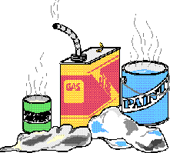
ACCIDENT ROOT CAUSES – ISHIKAWA DIAGRAM
4M + 1E
Man - experience, competency
Machine - equipment, tools etc
Material - involved
Method - procedure, WI etc
Environment - lighting, weather etc

Slide 30
MAN - COMPETENCY
To ensure all the personals follow the safety procedure at the production line with ‘0’ accident per year
=
+
+
COMPETENT WORKER
ATTITUDE
SKILL
KNOWLEDGE
Responsibility to follow the procedure
Identify the hazard occur
Use the correct method of handling
Understand the process
Understand the procedure during emergency

Slide 31
HOW TO CONTROL & PREVENT DUST EXPLOSION?

Slide 32
RISK CONTROL HIERARCHY
Most effective
Elimination - Removing/eradicate the hazard,
Fairly effective
Substitution - Replace/use less hazardous one,
Isolation - Segregate e.g. install screens or barriers,
Engineering control - Modification to the tools or equipment, provident guarding to machinery or equipment
at the source of hazard,
Least effective
Administrative control - Limit exposure , introduce work practices that reduce the risk,
Personal Protective Equipment - Only after other measures are not
(PPE) practicable or to increase protection .
“Last solution”

Slide 33
CONTROL MEASURE
(IN ORDER OF EFFECTIVENESS)
Elimination
  Total removal of hazardous chemicals/dust
  Use other processes that do not require the use of dust
Substitution
  Substitute with less hazardous substance
  E.g. water based instead of hexane

Slide 34
CONTROL MEASURE (CONT’D)
Enclosure
  Enclose the process completely to prevent or minimize release to the surrounding
Isolation
  Segregate workers from hazardous work or process
Modification
  Adjust operating conditions such as pressure, temperature, ventilation etc

Slide 35
CONTROL MEASURE (CONT’D)
Engineering Control Equipment
  LEV
  Ventilation
  Fume Cupboard
Safe work system and procedure
Personal Protective Equipment
  Last defense
  Correct PPE for specific conditions
  Correct size etc

Slide 36
Engineering Control Equipment
VENTILATION AT WORKPLACE
2 TYPES OF MECHANICAL VENTILATION
MECHANICAL (FORCE) VENTILATION
General (dilution) ventilation
Local exhaust ventilation (LEV)
Copyright @ Cerna Minda 2016

Slide 37
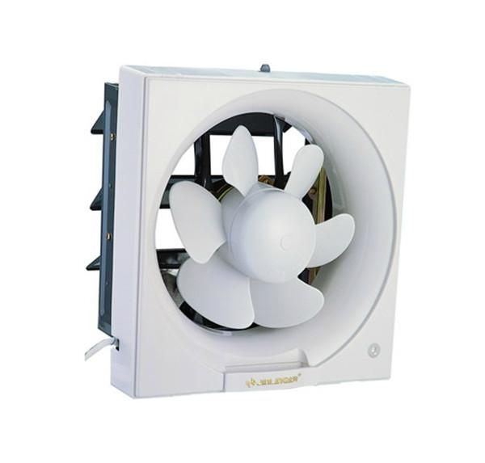
VENTILATION AT WORKPLACE
GENERAL DILUTION
General (dilution) ventilation systems supply clean air that mixes with the air in the workplace, diluting the concentration of the contaminant.

Slide 38
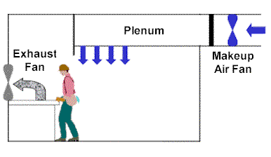
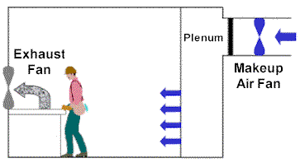
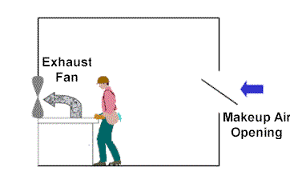
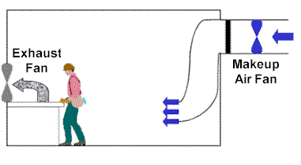
VENTILATION AT WORKPLACE
GENERAL DILUTION

Slide 39
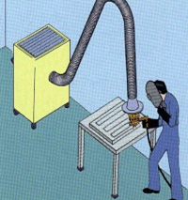
VENTILATION AT WORKPLACE
LOCAL EXHAUST VENTILATION

Slide 40
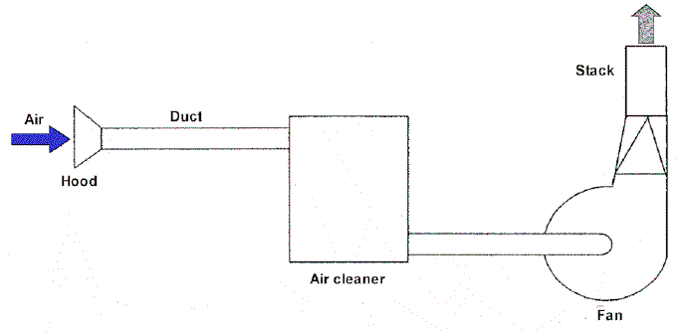
VENTILATION AT WORKPLACE
LOCAL EXHAUST VENTILATION
Main component LEV System
  hood
  ducts
  air cleaner (if needed)
  Fan / motor
  Stack / Chimney

Slide 41


CONTRL MEASURE (CONT’D)
Others
  Personal hygiene
  Training
  Monitoring of exposure
  Health surveillance
  Emergency Response Procedure
  First aid facilities
  PPE – Personal Protective Equipment

Slide 42
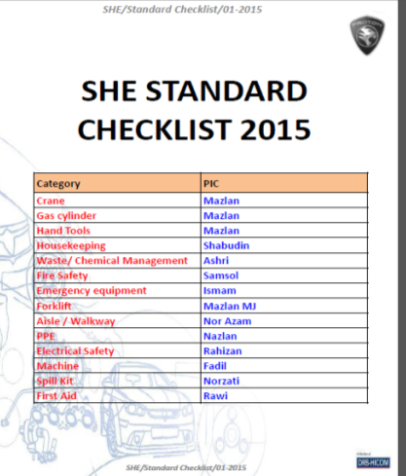
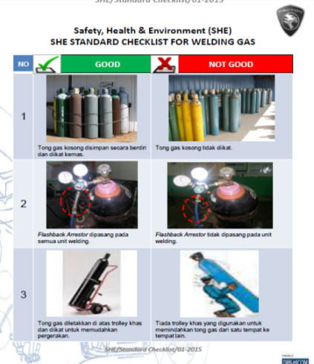
SOP & WORKING INSTRUCTION

Slide 43
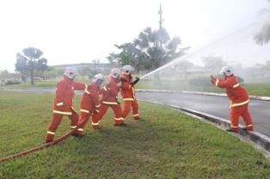
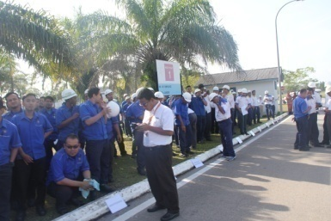
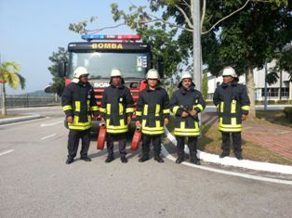
EMERGENCY PREPAREDNESS & RESPONSE
YEARLY EVACUATION / FIRE DRILL
To evaluate effectiveness of evacuation procedures and determining necessary changes or adjustments to emergency procedures

Slide 44
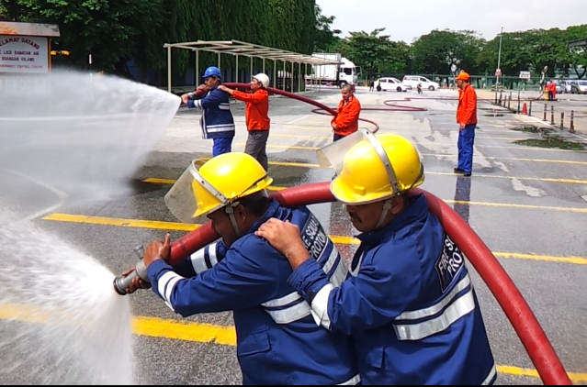

EMERGENCY PREPAREDNESS & RESPONSE
YEARLY EVACUATION / FIRE DRILL
DRILL EXERCISE PONSB
Safety, Health & Environment Department (SHE)
Safety, Health & Environment Department (SHE)

Slide 45
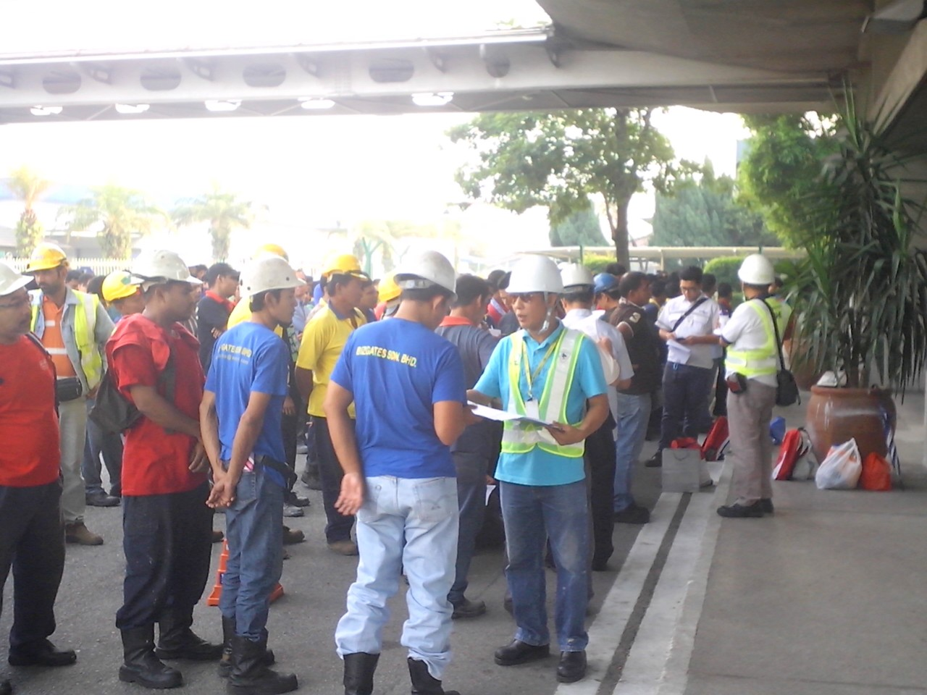
CONTRACTOR MONITORING
PERMIT TO WORK (PTW)

Slide 46


LEGAL REQUIREMENT
(UNDER FMA)
Control PEL – Permissible exposure limit
Conduct Exposure monitoring
Operation of control equipment, inspection and examination
Water spray
Respiratory protection
Housekeeping
Medical examination
Information and training

Slide 47
SIGN & LABEL
Hazard Sign
Precaution:
Avoid impact, knocks, friction, sparks, fires and heat.

Slide 48
Safety Rule 1
Treat every chemical as though it were hazardous

Slide 49
Safety Rule 2
Do not smoke, eat or drink when handling chemicals

Slide 50
Safety Rule 3
After handling chemicals wash hands before eating, drinking or smoking

Slide 51
Safety Rule 4
Do not sniff chemicals. Ensure you are wearing personal protective equipment (PPE)
POISON

Slide 52

Safety Rule 5
Keep chemicals away from sources of heat e.g. lighted match, lighters, burning stove.

Slide 53
Safety Rule 6
Handle chemicals at an open or well ventilated place

Slide 54
Safety Rule 7
Handle chemicals with care during transportation. Rough handling may cause spillage.

Slide 55
Safety Rule 8
When spilled with chemicals, take off contaminated clothes, wash affected body with plenty of water.

Slide 56
Safety Rule 9
Store chemicals in a separate room that is well ventilated.
Chemical Store
+
Safety
First

Slide 57
TOP SAFETY RULE
Understand the chemicals being used on site. Refer to CSDS (Chemical Safety Data Sheet)

Slide 58
SAFETY & HEALTH FOCUS
WORKPLACE
Employee
Process
Environment

Slide 59
CRITICAL SUCCESS FACTOR IN SAFETY & HEALTH
5%
STRATEGY
95%
EXECUTION
SUCCESS OSH RESULTS
(+ve results)
+
=
PLAN
DO & CHECK
ACT

Slide 60
TOWARDS A POSITIVE SAFETY & HEALTH CULTURE TO PREVENT ACCIDENT
Working Environment
Systems
People and Organization
-Plant & equipment integrity
Competencies-ASK
(Attitudes, Skills &
Knowledge)
SAFETY & HEALTH
CULTURE
-Management systems & procedures
It infuses every interaction, every behavior and every decision

Slide 61

BUSINESS STRATEGIES
BEYOND PROFITS – 3P
  Customers, Suppliers, Employees, Capital Providers, Public Product Responsibility
Materials, Energy, Biodiversity, Emissions, Effluents & Wastes
  Safety & Health, Labor Practices, Human Rights, Society & Community

Slide 62

norwani@proton.com
013-3851202
“Leadership is action, not position”
- McGannon-
Thank you

